Slide 1
Dating Preferences in Graduate Students
A Columbia University Speed Dating Experiment
Natasha Polishchuk MAT 443 Final Presentation

Slide 2
Background
Ratio of women:men:
- 5:4 in mid ’90s
- 4:3 in mid ‘00s
Attributed to emphasis on high school performance
Larger cities New York, Los Angeles, Chicago particularly competitive
Women feel men have more detached approach
Competitive environment also seen in Mormon and Orthodox Jewish communities
Notes:
Jon Birger: (Date-onomics — How Skewed Sex Ratios on College Campuses Are Affecting Courtship and Marriage) Men lag behind in educational development as teenagers. Women seek partners who are similar to them, including in educational level. Even in graduate school (60% female), men are less motivated to complete schooling, so Ambition a related and desired attribute? San Jose, Seattle, San Francisco better. Competition has side effects of eating disorders, plastic surgery, indicating need emphasis on appearance.

Slide 3

Original study
Fisman et al. (2008) found:
Women have strong preference for same-race, particularly minority
Men do not as a whole
Preference decreases with age
Linked to a subject’s background.
Notes:
This could not be explained by more shared interests or perception that the shared race was more attractive, but the subject’s place of origin did strongly influence this. . The author used the General Social Survey (GSS) and World Values Survey (WVS) to determine which places were less tolerant, and found that subjects from these regions had similar outlooks. Additionally, subjects who were themselves physically attractive cared were less likely to exhibit this preference.

Slide 4
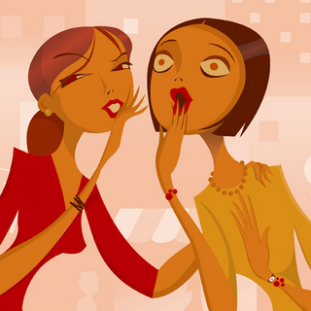
Purpose
Hypothesis: Because of the skewed sex ratio, women face a competitive environment in the Columbia graduate and professional student dating pool. They place greater emphasis on Ambition and Race and are less selective otherwise, whereas men focus on Attractiveness and are more selective.
Notes:
What additional qualities or factors that can

Slide 5
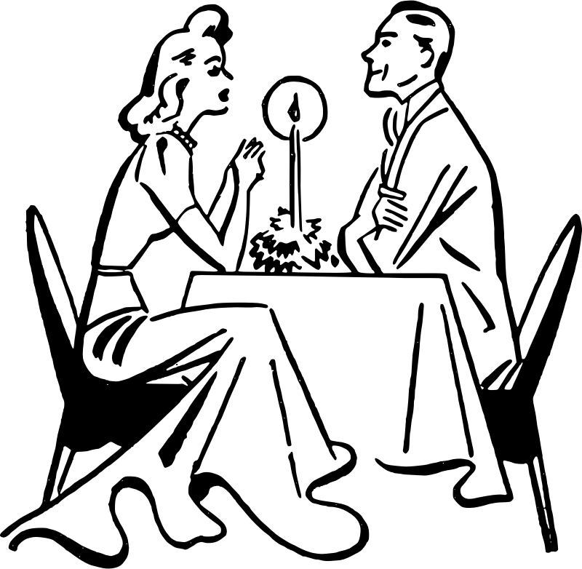
Design
Data set openly available with free registration at kaggle.com
21 Speed Dating events between 2002 and 2004
Students recruited via flyer, email
Completed surveys before, during, and after
Spoke to each opposite-sex participant for 4 minutes, with 1 minute breaks to complete:
1-10 Likert item: Attractive, Sincere, Intelligent, Fun, Ambitious, Shared Interests, and how much they liked them overall.
Notes:
Equal number of men and women at each event, atmosphere held constant at each, alcohol not served but otherwise similar to actual events held by the company Hurry Date. For each date, they also circled “yes” or “no” indicating whether they wanted to meet the person again (not used in this analysis, as focus was more on preference ratings than outcome). Two events held each night, so some self-selection may have occurred based on time of event, but this was not provided.

Slide 6
Select Variables
Age
Race
Field
Career Plan
Importance of Race
Importance of Religion
Frequency of Dates
Frequency of Social Outings
Zip
Interests
Expectation of happiness with the people to meet
Self-assessment
Notes:
Not all variables collected in study were used. Median household income based on zipcode using the Census Bureau website:
http://venus.census.gov/cdrom/lookup/CMD=LIST/DB=C90STF3B/LEV=ZIP
When there is no income it means that they are either from abroad or did not enter their zip code. Interests were (Sports, Museums, Art, etc. 17 categories). Self-assessment on attr3_1 Attractive, sinc3_1 Sincere, int3_1 Intelligent, fun3_1 Fun, amb3_1 Ambitious

Slide 7
Methodology
Analysis limited to four waves
PCA and MDPREF used to map ratings based on ratings in the Like variable.
Wave # | Date | # Males | # Females
6 | March 26th ‘03 | 5 | 5
7 | March 26th ‘03 | 16 | 16
8 | April 2nd ‘03 | 10 | 10
9 | April 2nd ‘03 | 20 | 20
Notes:
Limited because of complexity of interpretation, also in same week so seasonality or other time factors reduced. Provides range of smaller and larger groups.
This technique is designed for visualizing opinion-based responses for multiple subjects by multiple judges. At each event, each female was rated by all of the other males in the group, then eigenvalue decomposition was used to convert the males’ preferences into principal component variables (Truxillo, 2015). By default, this procedure accounts for missing data using variable means as initial estimates (The PRINQUAL Procedure). Because the data consisted of ordinal rankings, the MONOTONE option was selected for a nonmetric MDPREF analysis. Suspicion of a degenerate solution led to use of judges’ mean rankings for the few missing variables.

Slide 8
Sample Descriptives
Around 26, 27 yo
Race and religion more important to women
Date and go out with same frequency
Expectation of happiness neutral for both
Men placed more emphasis on Attractiveness
Women more on Ambition
Both placed highest weight on Intelligence
Notes:
the three most popular fields for both sexes were Business/Economics/Finance, Life Sciences, and Political Science. In Figure 2, Banking/Finance and Academic/Research are the most popular career plans for both sexes. Men and women in this sample have similar mindsets on educational and professional aspirations. Not important to dating.

Slide 9
Sample Descriptives
 |  | Ratings by the opposite sex
Females |  | Attr | Sinc | Intel | Fun | Amb | Shar
 | Average | 6.53 | 7.34 | 7.40 | 6.51 | 6.71 | 5.58
 | Std Dev | 1.05 | 0.61 | 0.55 | 0.87 | 0.63 | 0.75
Males |  | Attr | Sinc | Intel | Fun | Amb | Shar
 | Average | 6.09 | 7.32 | 7.64 | 6.62 | 7.28 | 5.91
 | Std Dev | 1.21 | 0.58 | 0.62 | 1.03 | 0.69 | 0.85
 |  | Self-Ratings
Females |  | Attr | Sinc | Intel | Fun | Amb
 | Average | 8.02 | 8.64 | 8.42 | 8.90 | 8.22
 | Std Dev | 0.96 | 1.19 | 1.09 | 0.86 | 1.33
Males |  | Attr | Sinc | Intel | Fun | Amb
 | Average | 7.06 | 8.24 | 7.39 | 8.53 | 7.47
 | Std Dev | 1.36 | 1.38 | 1.59 | 1.19 | 1.96
Notes:
On average, women found themselves to be more attractive than men by almost a full point (8.02, standard deviation of 0.96) whereas men rated themselves lowest on attractiveness (7.06, standard deviation of 1.36). Men also rated themselves more than a point less than women on Intelligence, and slightly lower on Ambition.
women saw themselves in a more favorable light, and rated themselves more highly in all categories than their dates. Men were perceived as significantly less Attractive, Sincere, and Fun than their self-perceptions. However, men were rated higher on Intelligence and Ambition than their own estimates. In fact, men received slightly better ratings on these two variables than they gave women. Self ratings did not correlate with good rankings.

Slide 10
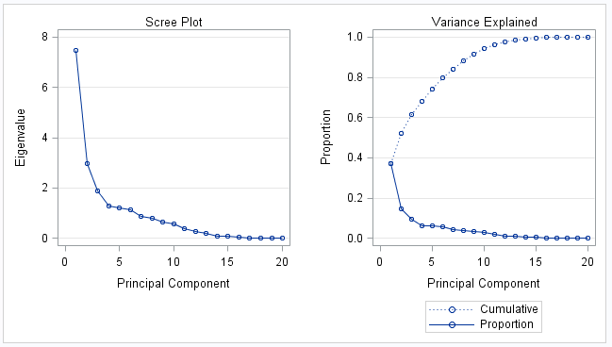
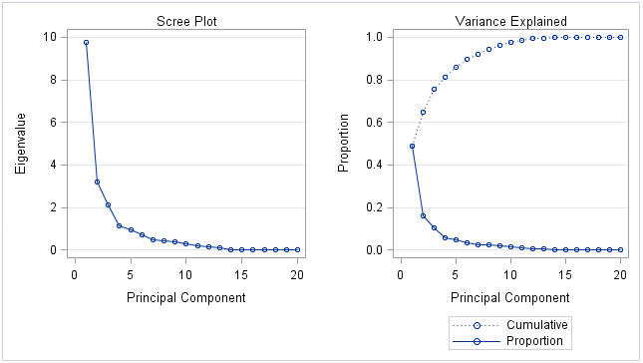
PCA
Final: 4 components explain ~80% of variance
Initial: 4 components explain ~70% of variance
Notes:
4-d chart would be ideal, but difficult to construct and interpret in 2-D space. Generally accepted in practice that 2 components explain majority of variance, and this is sufficient.

Slide 11
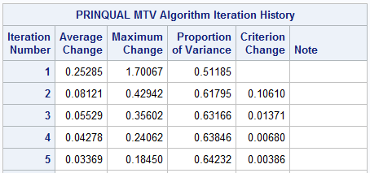
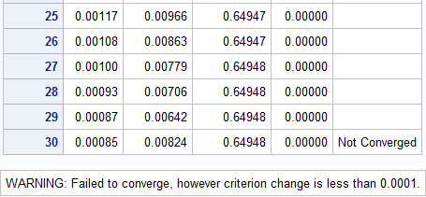
PRINQUAL Transform
Notes:
First attempt, the Average Change, Maximum Change, and Criterion Change begin to increase on the 23rd iteration, leading to suspicion of a degenerate solution. Abridged Iteration History with Single Missing Value Estimated as Mean. The algorithm does not converge, however the criterion change is small enough to indicate that more iterations are unlikely to have a significant effect. The variance increase is unchanged, still increasing from 0.51 to 0.65.

Slide 12
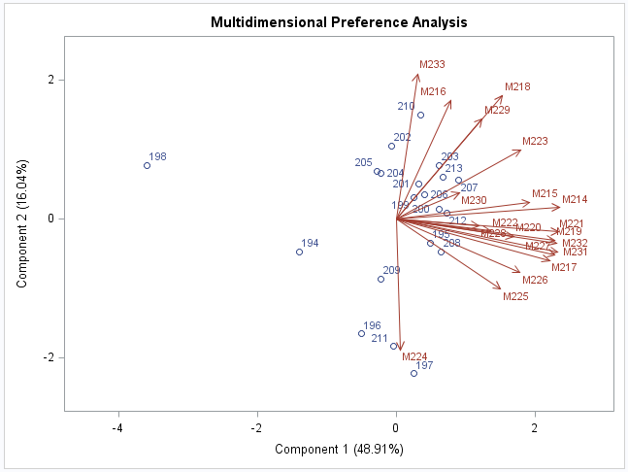
Biplot – Female Subjects in Wave 9
Notes:
In Figure 5, thirteen judges point to the right and slightly down (between 3 and 4 ‘o’ clock) in a tight vector grouping, with a few women (200, 212, 195, 208) projecting a short distance down the vectors. This grouping indicates the judges have similar preference patterns, but only moderate interest in these women. These women are all in their mid-20s, American, and rated higher than average on all attributes with the exception that 195 received a lower rating on ambition. They rated themselves higher than average on all attributes, and liked sports. This group is labeled “Confident Athletes”. The four judges grouped between 1 and 2 ‘o’ clock seem to be somewhat less selective, as six women are clustered within or around these vectors. Five of the six came from New York or New Jersey, and one was from Cameroon. With the exception of subject 199, all said they went out several times a week or twice a week. This group is labeled the “Northeastern Party Girls”. A few women are isolated on the right side of the map (198, 194, 196) with no admirers. These women received lower than average rankings in all attributes. 194 and 198 received only 4.6 for Attractiveness, a full 2 points less than average (6.5 with a standard deviation 0.99 for the other women at the same event). Only two judges have any strong preferences for the women; M233 for 210, and M224 for 197 and 211. No clear descriptive values appear as to how the women are grouped on the chart, though component 2 may be a weak race variable. Women on the top half are 70% White, 15% Hispanic, with one Asian and one Black woman. Women on the bottom half are 43% White, 29% Black, and one Asian and one Other woman.

Slide 13
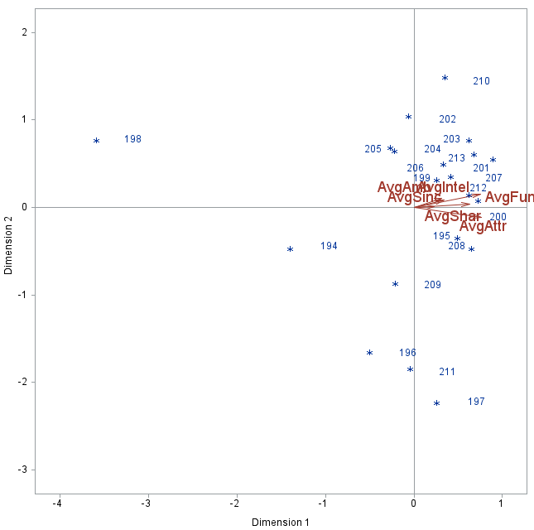
Wave 9 - Preference Mapping for Female Subjects with Attribute Rankings
Notes:
Women closer to the top of an attribute rating received more favorable appraisals. Because the vectors are so tightly clustered, it seems men do not make a large distinction between attribute ratings and Dimension 1 captures most of these rankings.

Slide 14
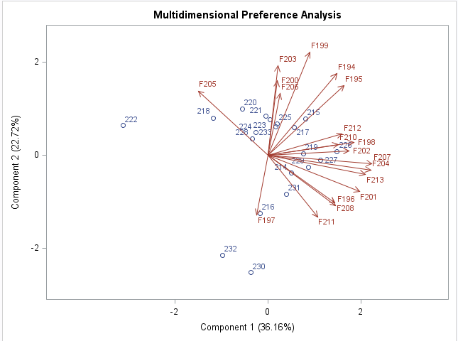
Biplot – Female Subjects in Wave 9
Notes:
Again, there are a large number of judges (11 in this case) grouped between 3 and 5 ‘o’ clock, with a moderate preference for a handful of subjects (231, 214, 229, 227, 219) and one stronger preference for subject 226 by judge F202. This cluster of men is confident, rating themselves higher than average on self-assessments, particularly in intelligence and ambition. Five out of the six are white, with one Hispanic subject. They are also from large cities in the US, with one exception from Spain, city not provided. Sixty-four percent of the judges in this area are also white, with 18% Asian and 18% Hispanic. Race plays a small but noticeable role in partner selection. This set is labeled the “Confident Urbanites”. A smaller group of six judges shows a moderate preference for subjects 223, 233, 225, 217, 215. This cluster is rated less attractive than the previous group, aged in their mid to late 20s, and with no majority of race. This group is called the “Mature Career-seekers”. This group and the “Confident Urbanites” are also the more selective judge cluster who only moderately liked four women. About half plan to pursue banking/finance, but this may not be relevant as 18/51 men plan to do this. Another cluster of four men (220, 221, 224, 228) is visible at the top of the chart, where three of the four are from other countries, and all received higher than average intelligence rankings. No judge vectors touch these directly, so it was possible that women admired their intellect but did not personally connect with the men. This set is labeled the “Solid Brains”.
Judges F205 and F197 face off into their own separate direction, with the latter showing a strong preference for subject 216. A couple men are not favored at all (222, 230). Subject 230 was the oldest at 42 years old. Although 232 was not well rated by most of the women and is distant from the other vectors, judge F197 rated him a 10 on the “Like” scale, so it is possible he is a divisive figure. Similarly, judge F205 gave 222 a 10 ranking, though most responded unfavorably to him. He received the lowest average rating on Attractiveness (3.2 as compared to an average of 5.97 with a standard deviation of 1.29 for men in Wave 9), but higher than average men in his group on Intelligence (8.2 as compared to 7.86 with a standard deviation of 0.56).

Slide 15
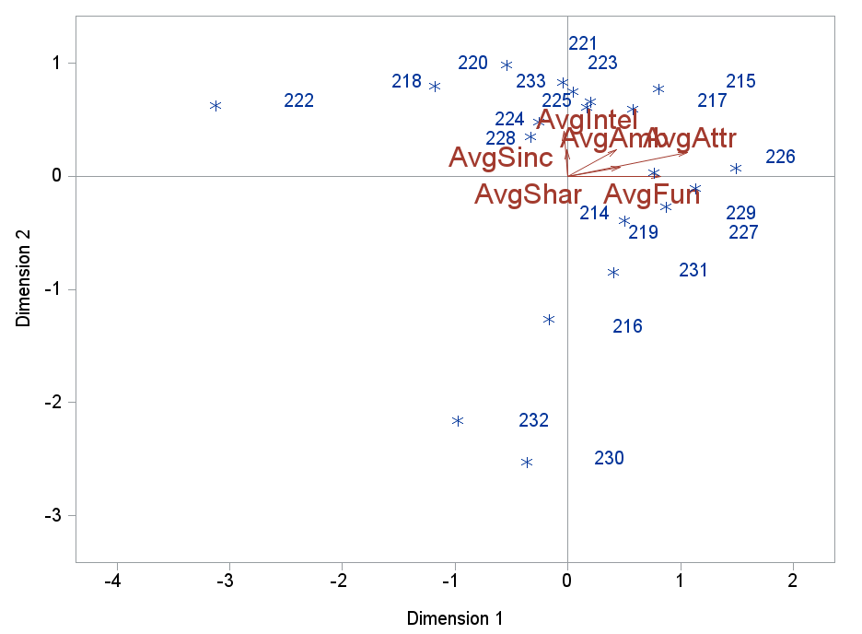
Wave 9 - Preference Mapping of Male Subjects with Attribute Rankings
Notes:
Figure 9 shows a broader than Figure 7. Rather than being clustered in a narrow thirty degree slice, the attributes are now distributed throughout the upper right quadrant. Intelligence and Sincerity point directly in the positive direction on Dimension 2, and Fun points directly in the positive direction in Dimension 1. The group we labeled “Confident Urbanites” is higher on the Shared Interests, Attractiveness, and Fun attributes, but is not favorably seen in the Intelligence and Sincerity categories. The “Mature Career-seekers” - higher on the Intelligence and Sincerity attributes, and still on the positive side of all other attributes. The final group, the “Solid Brains”, are also high on these two attributes, but thought to be less Fun, and is on the more negative side of Shared Interests and Attractiveness.

Slide 16
Wave 9 Conclusions
65% men favored a 20% of most attractive women who shared their interest in sports
20% less selective, liked 25% of women who were from NE, average or above attractiveness, and were socially active.
58% women favored a 30% of men who rated themselves highly, were Fun, and came from urban areas.
32% of women liked 25% of men with high Intelligent, Sincere, and Ambitious ratings, average or above average Attractiveness.
Notes:
Men: Attractiveness heavily influenced selection, though the effect of race is murky. Men were narrower in their rankings, probably ranking women similarly in all attributes if they liked them as a whole.
Women: Majority of women liked mostly white (4/5) group of men. Next group diverse in race.
High Intelligence and Sincerity with Low Attractiveness = few takers. Older man (42 years old) liked by only one judge. Fewer men in dead zone.
Both sexes prefer good-looking people. Some men also want women who share their interest in sports or go out frequently. People in the desirable groups are more selective, but a greater fraction of men are considered desirable than women. Some women place greater emphasis on men being smart and driven rather than their hobbies, but few would select a smart man who was not decent-looking. Confidence, origin, and age may be factors. Race may be factor for women

Slide 17
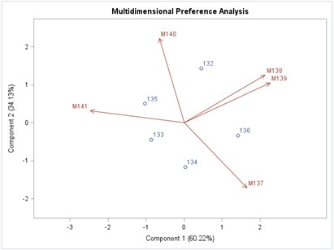
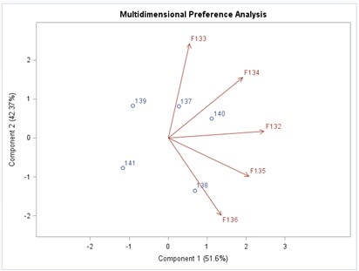
Validation – Wave 6
Male Judges
Female Judges
Notes:
Small sample size, hard logistically to increase. Compare to other waves to look for similar patterns. Wave 6: 5 men, 5 women. Men don’t like any of these women much, rated low for attractiveness, but high on other factors. 2 female judges really liked: F133 responding to subject 137, who shared her race (Asian), went out more, rated himself higher than she did, and from wealthy NY zip and F136 liked subject 138. She did not complete survey, so unknown, but subject 138 rated highly in all categories, aged 32, White, wealthy CT zip, Banking/Finance, and rated himself slightly higher than avg on Attractiveness, Intelligence, and Ambition. Subject 141 least-liked, Hispanic and the female non-Hispanic participants rated the importance of race highly (8 or greater).

Slide 18
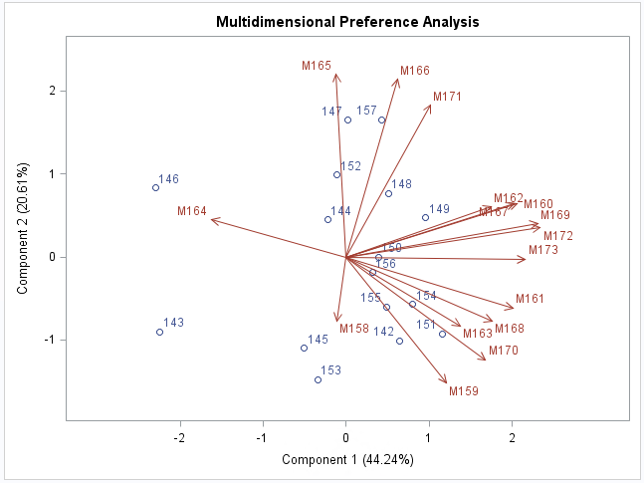
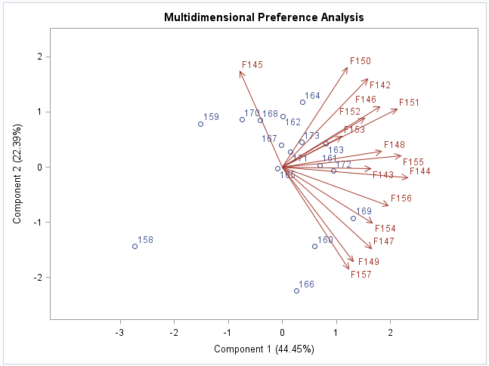
Validation – Wave 7
Male Judges
Female Judges
Notes:
Six of the sixteen men (37.5%) very selective, only mild preference for Subjects 150 and 149: both American, white, received slightly higher ratings than average, 28 and 30 years old. 5 judges between 4 and 5 ‘o’ clock liked 5 who were from big cities, went out multiple times weekly, rate themselves highly, and are rated attractive. 2 women with average ratings but were well-liked by judges M165 and M166. These women also went out frequently, liked sports more than the average, but did not rate themselves as highly as the previous group. Subject 143 was liked the least, and she was rated lowest on Attractiveness, Fun, and Shared Interests. She was also older at 33, did not date or go out frequently, but did rate herself highly, with scores between 8 and 10 on most attributes.
10 female judges between 1 and 3 ‘o’ clock showed preference for 5 men who had been in the more selective group. Above average Intelligence and Sincerity, and average to above average on Attractiveness. White, rated themselves high, except for a Londoner, who had highest rating for Ambition.
Subjects 164, 162, and 167 were in a group between two judges, but not especially liked by any female. Subjects 162 and 167 were rated average or below average on all rankings, though Subject 164 was rated highly on all categories but Ambition and was from Los Angeles. All three rated themselves lower than average, so may have been lacking confidence. The least liked subject was the 23 year old astrophysicist coded as 158, who had lowest Fun and Shared Interests, and below average ratings in the other categories.

Slide 19
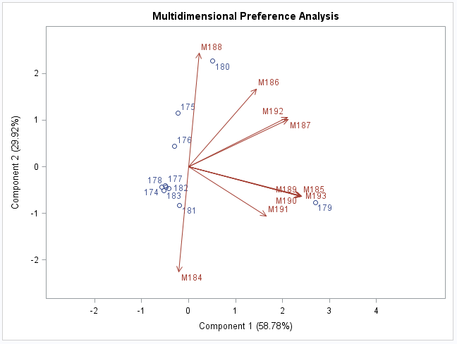
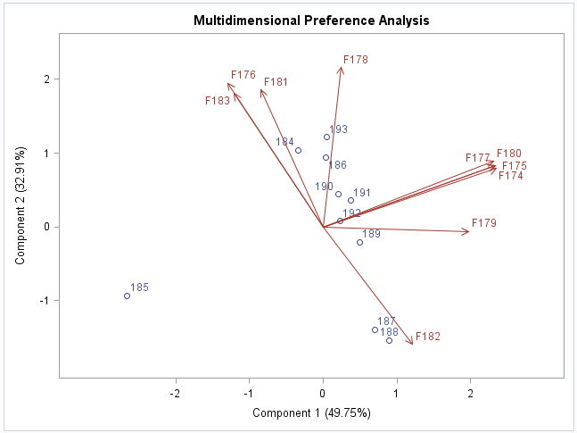
Validation – Wave 8
Male Judges
Female Judges
Notes:
Most men didn’t like the women much. Cluster of 5, are 5 lowest on attractiveness, don’t like sports, but from urban areas. M188 <3 180, an Asian woman from Taiwan, high Attractiveness and Fun. 4 judges loved subject 179, rated highest in Attractiveness, Fun, Ambition, and Intellect, a 30 yo Hispanic woman from a wealthy area in California who did not date or go out often, and did not rate herself especially highly.
She didn’t like any of the men. 4 judges didn’t like anyone much. One judge (F182) gave the highest “Like” rating to the two men that had the lowest ratings in all categories. They were both White men from New York and Atlanta who go out several times a week, herself a black female from New Jersey who only went out once a week. Some unknown factor? Subject 185 least-liked, rated himself a 10 on Attractiveness and Sincerity, 25 year old Asian man from Queens -rated below average on every ranking.

Slide 20
Summary
Male selection:
Beauty: desired half choose top most attractive women
Hangout: minority choose average or above average looking women who are fun or like sports
Less attractive women not selected
Female selection:
Charm: half of women choose top most attractive, confident men
Brains: minority choose average or above average looking men who are smart and ambitious
Less attractive men still have a few admirers
Notes:
Does not appear to be strong race preference in men. Women do have this, possibly also for age. Less uniformity across rankings than men. Look for Ambition, Intelligence, and slightly less focused on looks, with a few judges every time who like those rated low for Attractiveness. If men have either of these desirable traits, they are more selective. Somewhat true but less so for women. Not as simple as Jon Birger interview, but visible selection patterns.

Slide 21
Recommendations
Survey design favored first impressions – what results would 10 minute dates return? 30? 60?
Control for people who are friends, acquaintances
Other variables for rankings: Confidence, Grooming, Humor
More detailed self-descriptors: Height, Speech, English
How did follow up dates go?

Slide 22
Limitations
Limited group
Nonparametric, subjective testing
Unknown conversation topics and mood of participants
Small age range
1st 2 PCA components only explained ~60% of variance

